Slide 2
1

Slide 4
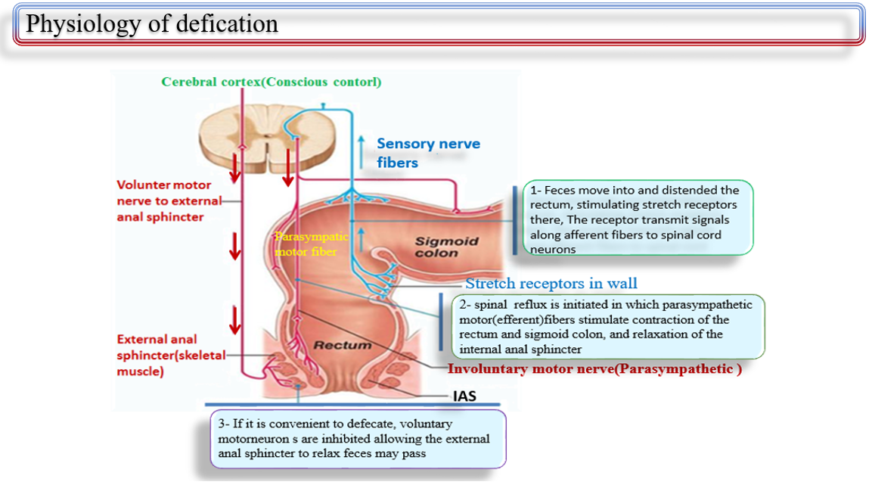
3

Slide 6
5

Slide 7
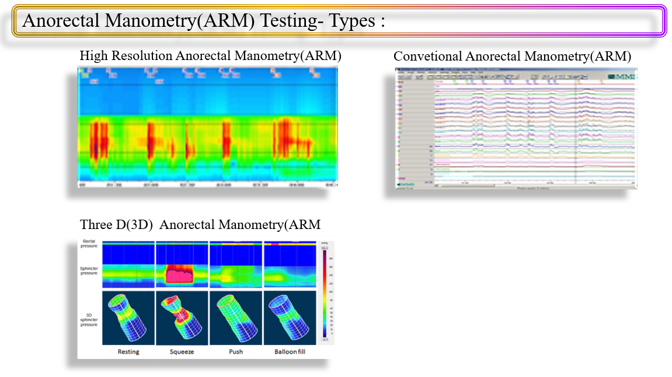
6

Slide 8
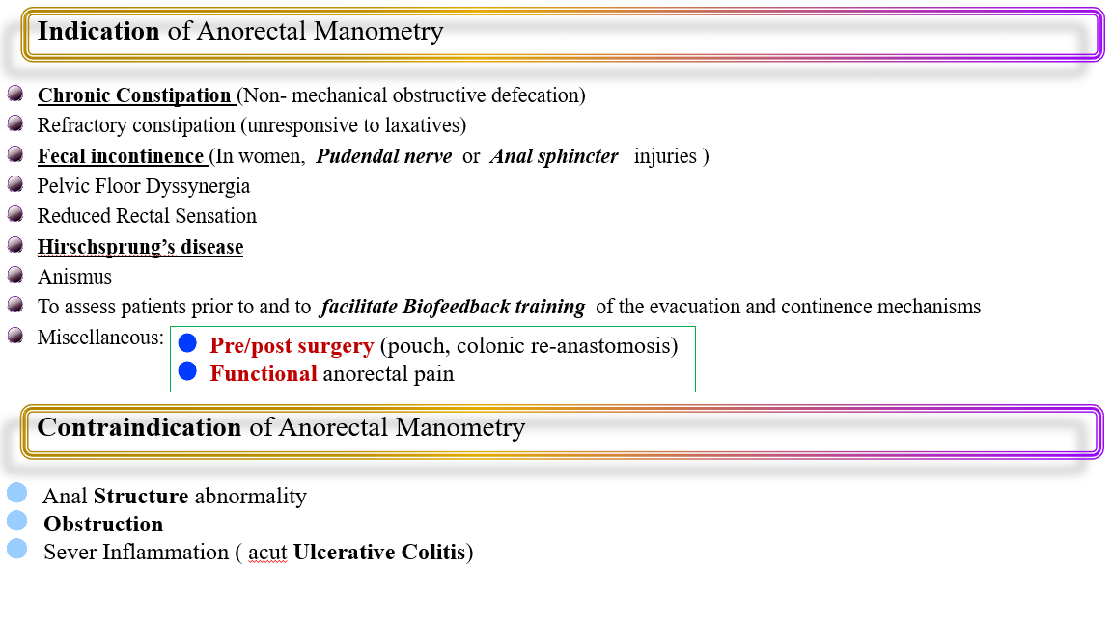
7

Slide 10
9

Slide 11
10

Slide 12
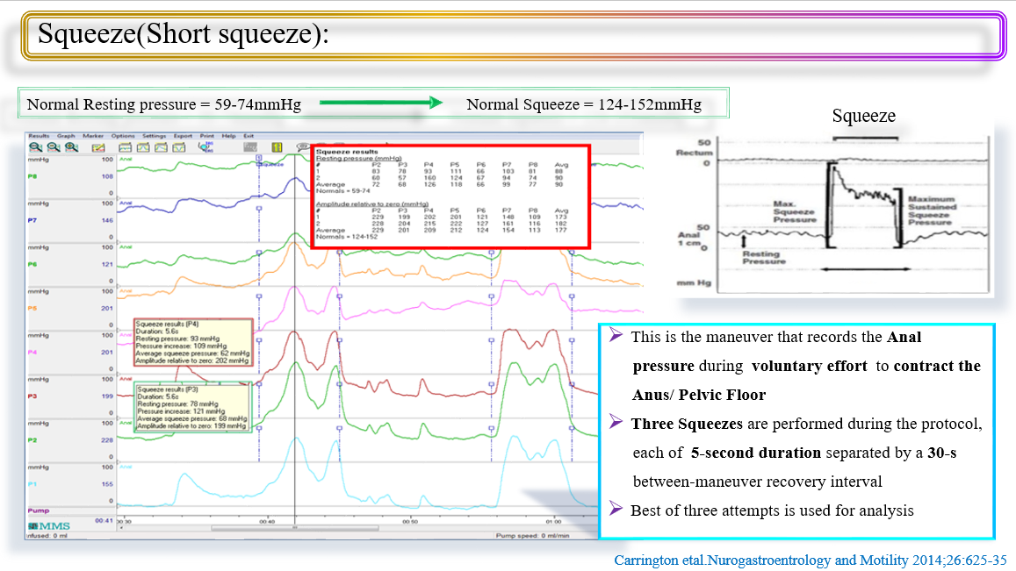

Slide 13
12

Slide 14
13

Slide 15
14

Slide 16
15

Slide 17
16

Slide 18
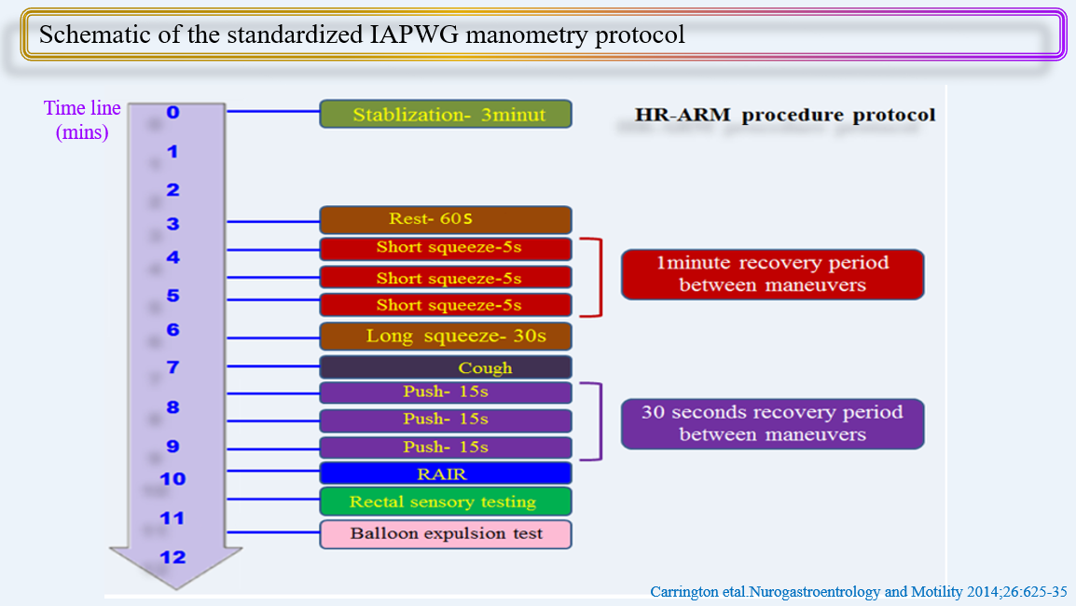
17

Slide 19
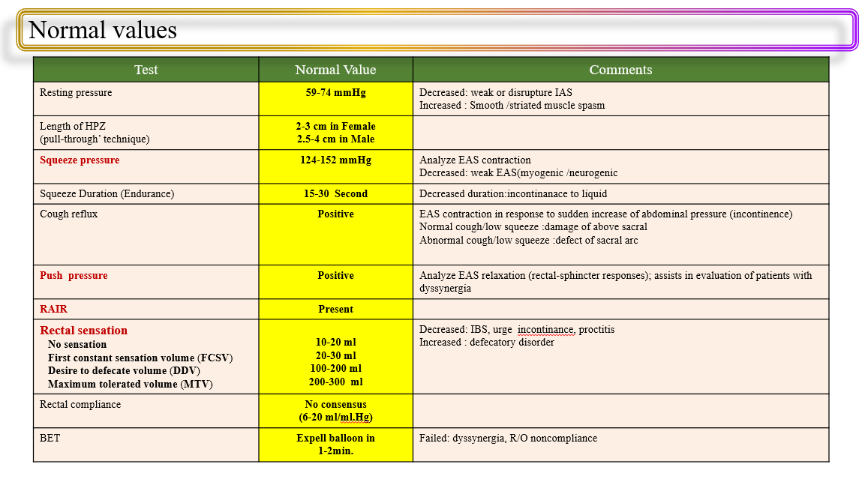

Slide 20
London classification for disorders of anorectal function
London protocol
Carrington et al.Neurogastroenterology & Motility2020;32:e13679
Scott etal.Current Gastroenterology Reports2020;22:55

Slide 21
20

Slide 22
21

Slide 23
22

Slide 24
23

Slide 25
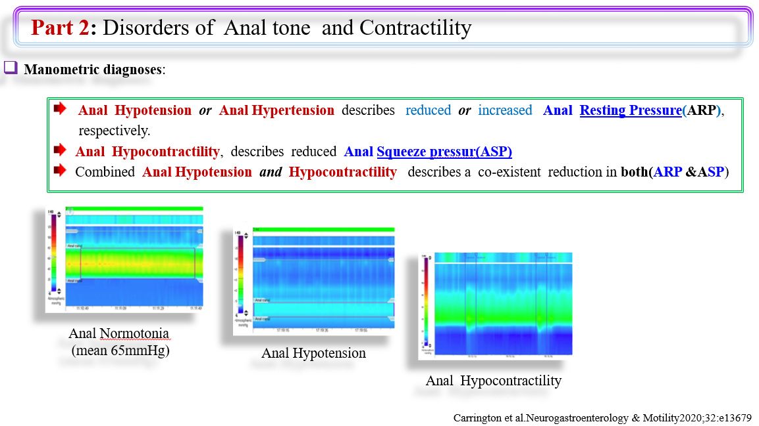
24

Slide 26
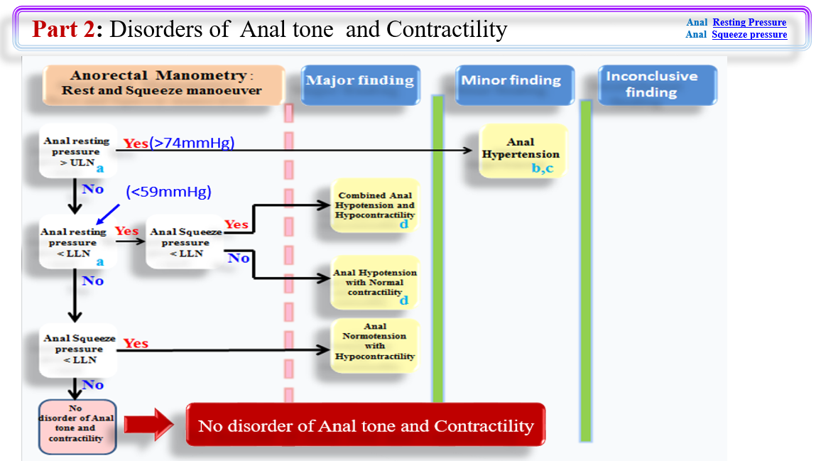
Carrington et al.Neurogastroenterology & Motility2020;32:e13679

Slide 27
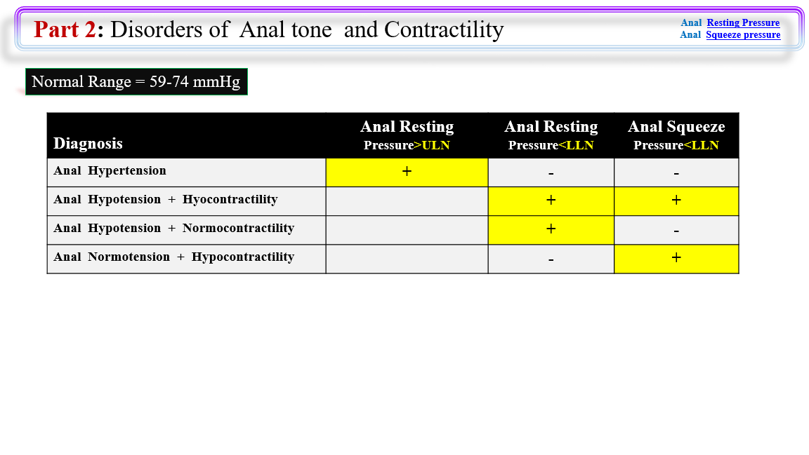
26
Carrington et al.Neurogastroenterology & Motility2020;32:e13679

Slide 28
27

Slide 29
28

Slide 31
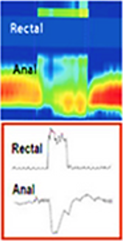
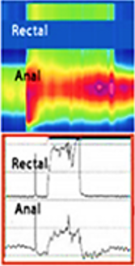
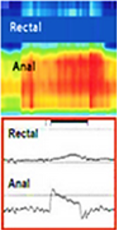
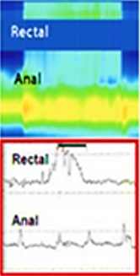
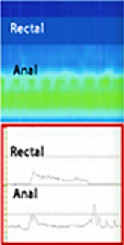
Part 3: Disorders of Rectoanal coordination
All results to be Akin to Type I Dyssynergia, Type IV Dyssynergia, Type II Dyssynergia
Diagnosis | Abnormal Balloon Expulsion Test | Rectal pressure increase during Push>LLN | Anal pressure decrease(Relaxation)during Push>LLN | Any abnormal pattern of anorectal coordination | DD Types
Abnormal Expulsion with normal Manometric pattern of Rectoanal coordination | + | + | +
Abnormal Expulsion with Dyssynergia | + | + | - |  | 1 or 3
Abnormal Expulsion with poor propulsion | + | - | +
Abnormal Expulsion with poor propulsion + Dyssnergia | + | - | - |  | 2 & 4
Normal Expulsion with abnormal manometric pattern of Rectoanal coordination | - |  |  | + | 1- 4
Normal
Type 1
Type 2
Type 3
Type 4
Carrington et al.Neurogastroenterology & Motility2020;32:e13679
30

Slide 32
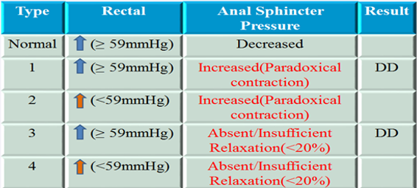
Dyssynergic Defecation(DD)
Type 1- Patientis unable to generate an adequate pushing force(no increase in intra rectal pressure)
but can exhibit a paradoxical anal contraction
Type2- Patient is unable togenerate an adequate pushing force(no increase in intra rectal pressure)
but can exhibit aparadoxical anal contraction
Type3- Patient can generate an adequate pushing force(increase in intra rectal pressure) but, either
has absent or incomplete(<20%) sphincter relaxation (i.e.,no decrease in anal sphincter
pressure)
Type 4- patient is unable to generate an adequate pushing force and demonstrates ana bsent or in
complete anal sphincter relaxation
Normal
Type 1
Type 2
Type 3
Type 4
31
Patcharatrakul etal.Gut and Liver 2018;12(4):375-84

Slide 33
32
Gastroentrology and Hepathology.2018 Macmillan Publishers

Slide 34
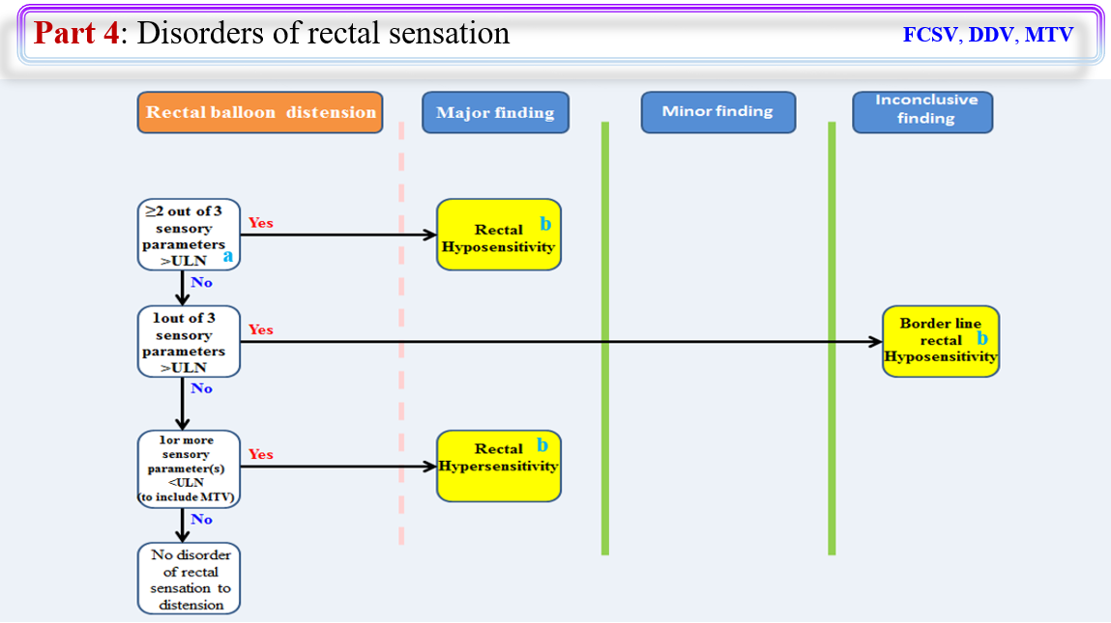
33
Gastroentrology and Hepathology.2018 Macmillan Publishers

Slide 35
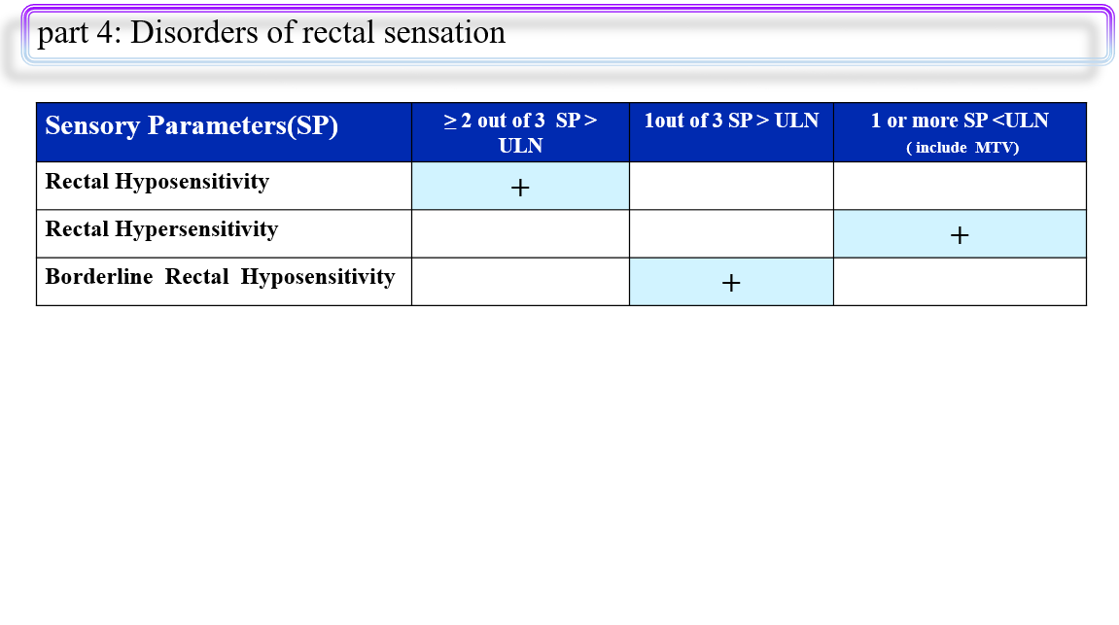
34
Gastroentrology and Hepathology.2018 Macmillan Publishers

Slide 36
35

Slide 37
Comparison between the London classification and conventional nomenclature for high-resolution anorectal manometry
London Classification | Conventional Nomenclature
Major disorders
Anal hypotension with hypocontractility | Alteration (hypotonia) of the internal anal sphincter. Alteration of the external anal sphincter
Anal hypotension with normal contractility | Alteration (hypotonia) of the internal anal sphincter
Normal anal tone with hypocontractility | Alteration or dysfunction of the external anal sphincter
Rectal hyposensitivity | Rectal hyposensitivity disorders
Rectal hypersensitivity | Rectal hypersensitivity disorders
Rectoanal Areflexia | Absent inhibitory rectoanal reflex
Minor disorders
Anal hypertension | Hypertonic anal sphincter
Abnormal expulsion with dyssynergia | Type I or type III defecation dyssynergia
Abnormal expulsion with poor propulsion | Not applicable
Abnormal expulsion with poor propulsion and dyssynergia | Type II or type IV defecation dyssynergia
Inconclusive disorders
Abnormal expulsion with normal anorectal coordination | Abnormal balloon expulsion
Normal expulsion with abnormal anorectal coordination | Type I - IV defecation dyssynergia
Borderline rectal hyposensitivity | Not applicable
36
DOI: https://doi.org/10.22516/25007440.484

Slide 38
Tanks
Dr.Hashem Fakhre Yaseri
2023

